Slide 1
DESIGN WEB APPLICATION TRAIN SCHEDULE
VIA TREE AMAY ERLIKASNA S
C30109190127

Slide 2
Introduction
LA station train schedule is designed to make it easier for users to view train schedules anywhere. All train scheduling processes are still done manually by system.
This system let the admin publish train departure and train arrival times It also allows user to interact directly with the customer service by contacting us by email that is displayed in the web application.

Slide 3
Project Outline
Research
System Scope
Problem Statement
The author makes observations and surveys what the website should look.
Meaning more emphasis on the design of the information display format.
The author is using firebase as the database because it also includes hosting at the database itself is easy to develop and maintain.
Visitors to this page can get information and train timetables on this website. This website also has an admin login area to assist in providing the most recent updates.
Objectives
Target User
Developing a Dynamic Website that is used to provide various information about train easily and faster.
Opening the Insights of the Internet Users so that they will be able to Utilize the Existing Resources.
Design online train schedule tracking website is an online publication tool for internet users that are read all over the globe.

Slide 4
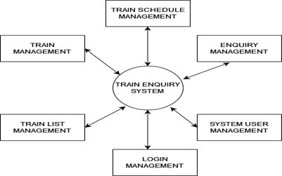
Design of train schedule
DFD Level 0

Slide 5
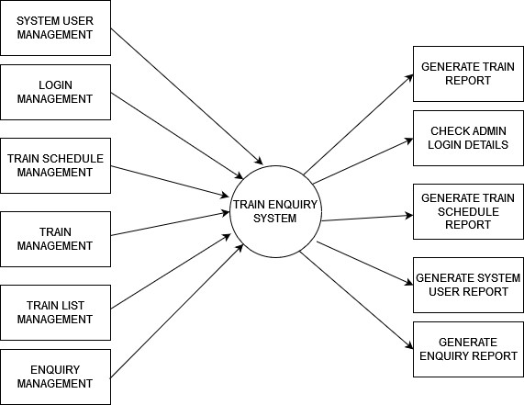
Design of train schedule
DFD Level 1

Slide 6
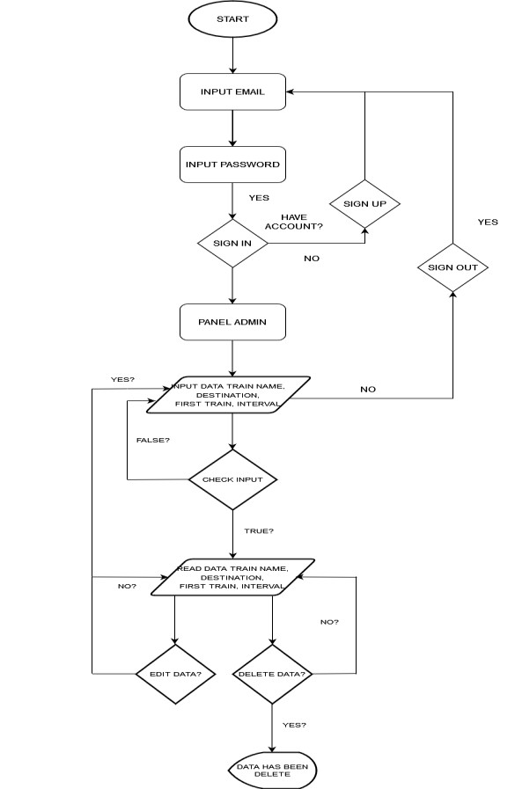
Design of train schedule
Flowchart

Slide 7
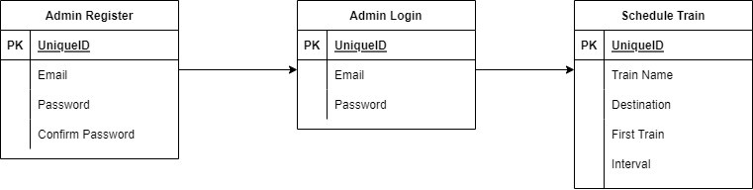
Design of train schedule
Data Modeling

Slide 8
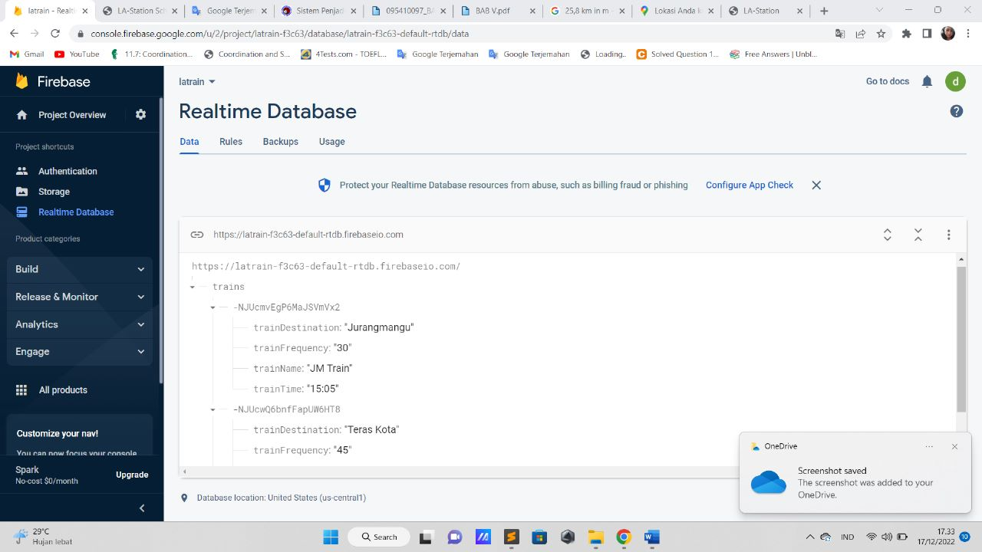

Design of train schedule
Database

Slide 9
Testing
 | Test Case | Expected Output | Actual | Criteria
1 | Admin and user open the program | The program should open | Successfully open the program | PASS
2 | Admin input username and password in Login form to open the admin page | After fill the form and login the admin page should open If wrong email or password will display alert The password is invalid or the user does not have a password. | Successfully open the program | PASS
3 | Admin fill the form of train schedule | Admin fill the data. The form should read the data | Succesfully Read data | PASS
4 | Admin can edit form train schedule | edited data can be displayed | Succesfully edit data | PASS
5 | Admin can delete the form train schedule | deleted data has been deleted | Succesfully delete data | PASS
6 | User can read the train schedule | Schedule page display the train schedule | Succesfully read data | PASS
7 | User can click the call center | Redirect to a phone call | Succesfully call the call center | PASS

Slide 10
Configuration
Hardware : Intel® Core™ i5 – RADEON @ 1,6 GHz
Operating System: Windows 10 Home Single Language 64-bit
Software : Eclipse IDE
Project Files Details | Project Files Details
1. | Train schedule | Sublime
2. | Train | Firebase
3. | Viathree_30109190127_CPP401.docx | Microsoft Word that contains Documents
4. | Viathree_30109190127_CPP401.pptx | Microsoft Powerpoint that contains presentation

Slide 11
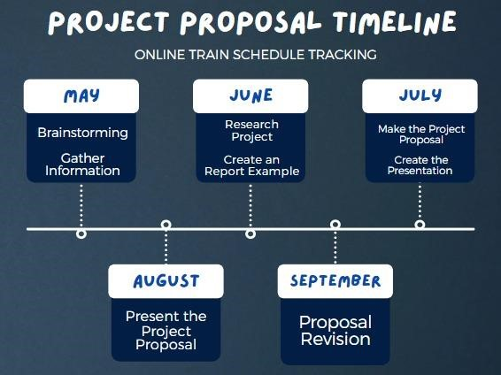
Timeline

Slide 12
Let’s see the website
..\Videos\K-project\K-project\index.html

